Slide 1
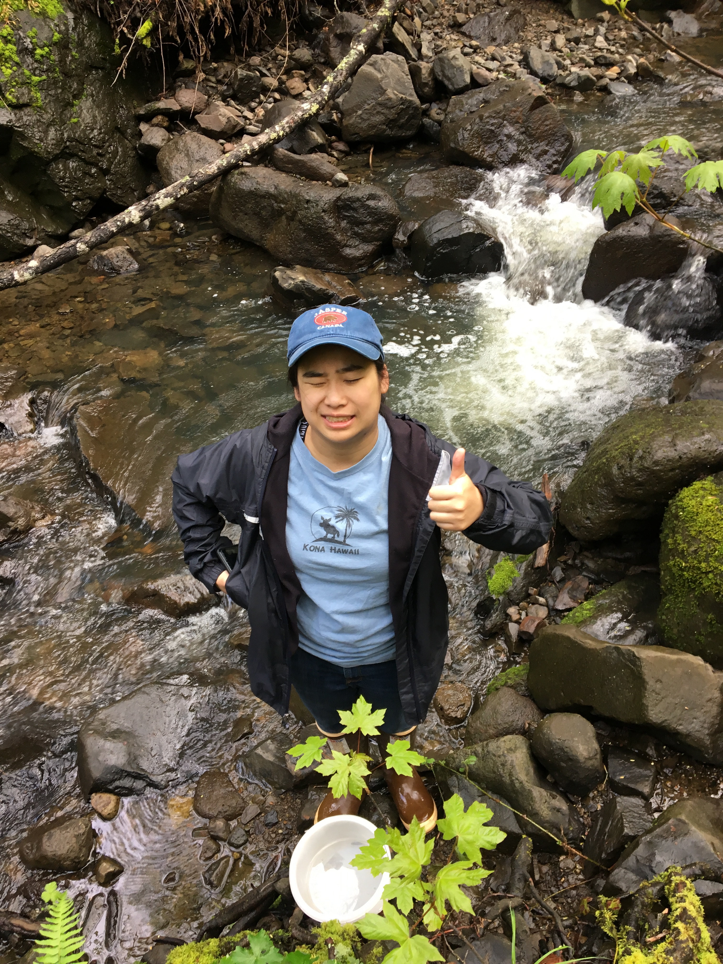
Assessing Abundance of Stream Insects at Fairfield Osborn Preserve
Kayla Morales, Elias Lopez, Chloe Howard, Dr. Nathan Rank
Sonoma State University
Abstract
Many insect populations have been shown to be decreasing. Comparing current insect populations to historical ones can help us understand this problem. The Fairfield Osborn Preserve is conveniently located and relatively undisturbed. “A Rearing Imperative: Associating Immature and Adult Stream Insects”, a thesis written by Lawrence Serpa, has an outstanding inventory of every insect found with descriptions, locations, and abundances at Fairfield Osborn Preserve. For my project, the preserve was visited a total of 5 times, including one preliminary visitation, to select freshwater aquatic insects. I searched for insects described in Serpa's thesis, specifically those most prevalent in spring and easily identifiable. My findings were compared to those of Lawrence Serpa. Upon sorting, I determined whether the insects collected are still common. By comparing my findings with Serpa's thesis, any changes in diversity or population in the Fairfield Osborn Preserve can be evaluated.
Materials and Methods
The materials used in this experiment were 1 Aquatic D-net, a dissecting microscope, a bowl to gather each sample, 70% ethanol, 12 50 mL centrifuge tubes, forceps, plastic pipettes, and 1 and 4 dram vials for sorting.
The Fairfield Osborn Preserve was visited a total of 5 times; 1 preliminary visit to determine sampling sites and techniques and 4 sampling visits during the Spring. 4 sited were chosen, 3 along Copeland Creek and 1 at the perennial spring. At random points in each designated sampling site, one person held the D-net at locations with stronger water flow and high cobble while the other rubbed each cobble or hard surface in a small quadrat. The contents of the net are then placed in a water bowl and each insect is collected in a 50 mL centrifuge filled with 70% ethanol. This is done once per sampling site. After each sampling visit, the samples are sorted by species for each sampling site and recorded.
Results
Conclusions
Ecological settings can be difficult to conduct long-term experiments given that it is impossible to have a control. The Fairfield Osborn Preserve is unique in its ability to eliminate variables that could compromise an experiment because it has been so well protected for decades. After careful review of Serpa’s thesis on stream insects and newfound collected insects, we were able to conclude that while there have been changes in abundance since 1980, there were many species that were able to retain abundance. Nearly all of the common species I found in my study were already abundant when Serpa conducted his thesis research. Given the data gathered, this could provide insight into how Fairfield Osborn Preserve is able to prevent ecological changes that have been happening in unprotected areas.
Water Penny | Cinygma integrum | Water Penny | Longhorned Case-Maker Caddisfly
Diving Beetle | Cordulegaster dorsalis | Black Fly | Pronggilled Mayfly
Agathon doanei | Dixa chaloensis | Graptocorixa californica | Polycentropus variegatus
Aquarius remigis | Fingernet Caddisfly | Northern Case-Maker Caddisfly | Fingernet Caddisfly
Argia vivida | Spiny Crawler Mayfly | Flat headed Mayfly | Rhyacophila vedra
Small Minnow Mayfly | Elodes sp. | Lara avara | Rhyacophila vocala
Common Stonefly | Epeorus longimanus | Common Netspinner Caddisfly
Fig. 1 (above)
List of most prevalent aquatic insect species from Serpa’s thesis.
Literature Cited
Serpa, Lawrence E. “The Rearing Imperative: Associating Immature and Adult Stream Insects.” 1986. Master’s thesis submitted to Sonoma State University.
Voshell, J. Reese. A Guide to Common Freshwater Invertebrates of North America. McDonald & Woodward Pub., 2003.
Acknowledgments
Lawrence Serpa was kind enough to assist me with any questions or concerns I had during this research. As an expert in freshwater aquatic insects at FOP, his insight was invaluable. Elias Lopez was able to assist and instruct me on techniques needed for this research in sampling and sorting, this project would’ve been significantly more challenging without his help. Chloe Howard was always willing to help out and became a crucial part of this project. This project was funded by the CEI Waters Collaborative Research Grant.
Fig. 2 (above)
This graph shows the abundance of each species collected from my samples. The species in orange are the species that were also found in Serpa’s research. The species in green are the species which were not particularly abundant during his research.
The results of this experiment show that while many of the abundant species from Serpa’s thesis weren’t collected, most of the species that were found to be abundant in my study were also highly abundant from Serpa’s study. This shows that there is a definite change in biodiversity favoring a select few species. For example, small minnow and spiny crawler mayflies are now especially abundant.
Notes:
Copyright Colin Purrington (http://colinpurrington.com/tips/academic/posterdesign).

